Slide 1




Impala: Algorithm/Architecture Co-Design for In-Memory Multi-Stride Pattern Matching
The 26th IEEE International Symposium on High-Performance Computer Architecture (HPCA 2020)
Elaheh Sadredini*, Reza Rahimi*, Marzieh Lenjani,
Mircea Stan, and Kevin Skadron
I am in the academic job market this year!
* Equal contribution
** This work is funded, in part, by the NSF (CCF-1629450) and CRISP, one of six centers in JUMP, a Semiconductor Research Corporation (SRC) program sponsored by MARCO and DARPA.

Slide 2

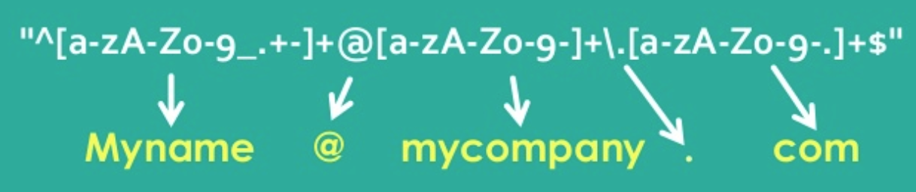
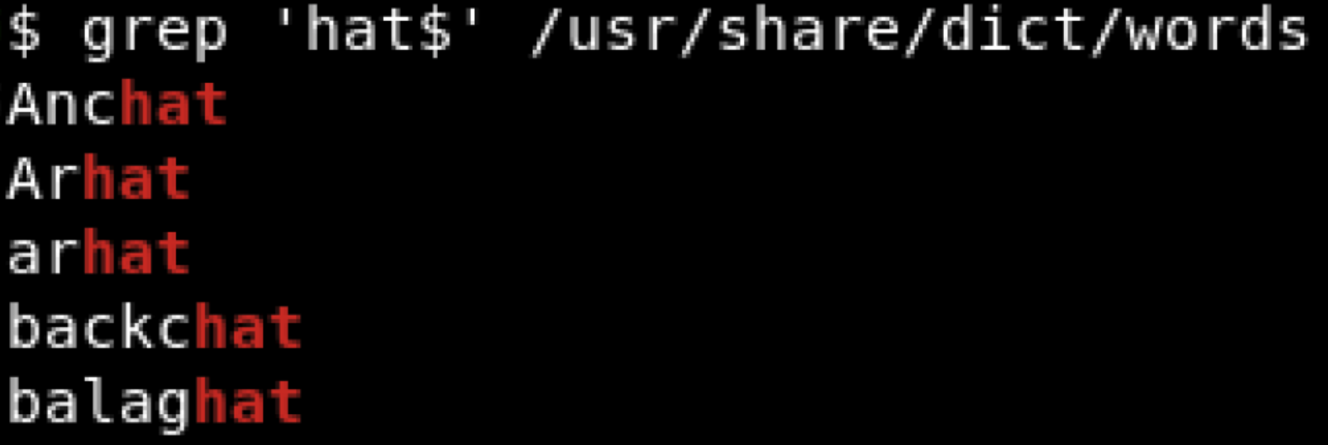
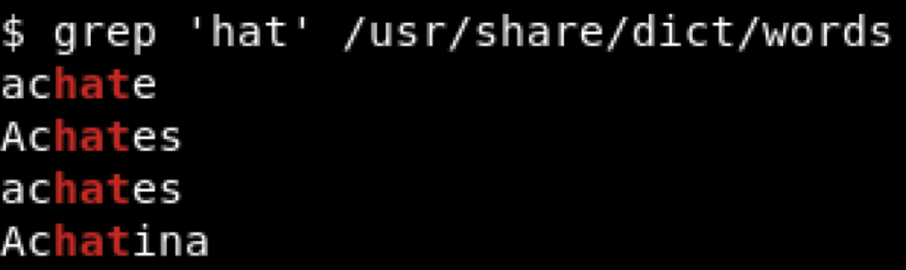

Slide 3


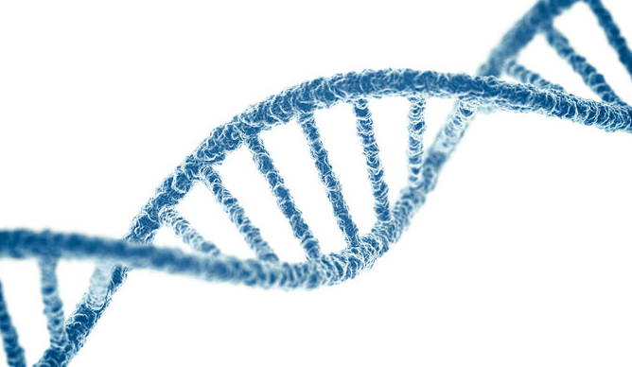



Pattern Processing Is the Performance Bottleneck in Many Big-Data Applications
Bioinformatics
Network Security
Marketing
Virus Scanning
Database
Natural Language Processing

Slide 4


Motivating Example: Network Security
Increasing network line rate
Rule size or complexity
Packet
Snort Rule Set
Rule 1
Rule 2
. . .
Rule N
Network Intrusion Detection System
Malicious
or
Non-malicious
Demand for high-throughput pattern matching

Slide 5
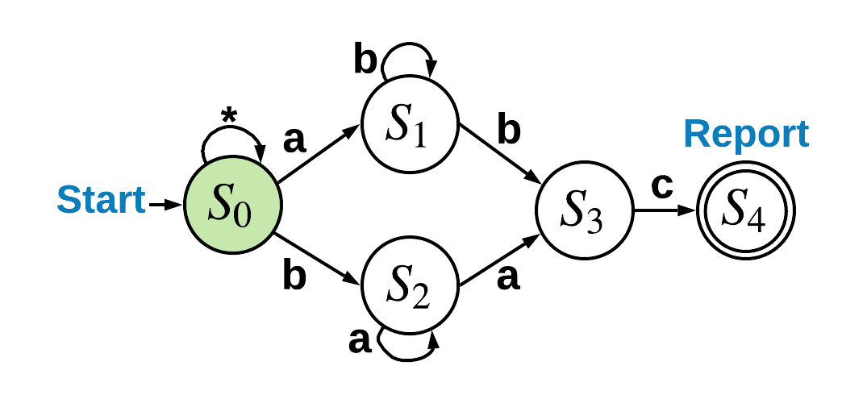
Finite Automata for Pattern Recognition Languages
Regular expression: (ab+|ba+) c
Deterministic
Finite Automata (DFA)
Non-deterministic
Finite Automata (NFA)
Non-deterministic Finite Automata (NFA)

Slide 6
Finite Automata for Pattern Recognition Languages
Regular expression: (ab+|ba+) c
Input:
a
Non-deterministic Finite Automata (NFA)

Slide 7
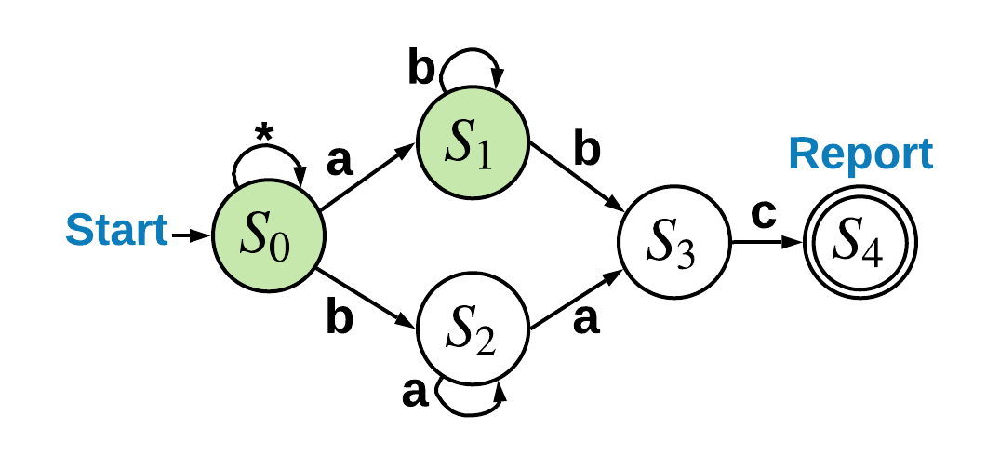
Finite Automata for Pattern Recognition Languages
Regular expression: (ab+|ba+) c
Input:
a
Non-deterministic Finite Automata (NFA)

Slide 8
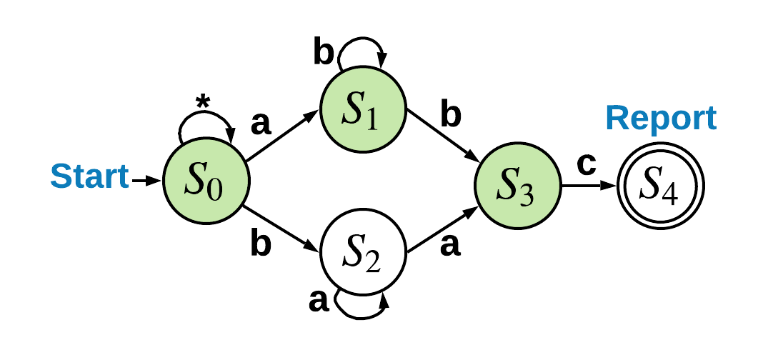
Finite Automata for Pattern Recognition Languages
Regular expression: (ab+|ba+) c
Input:
a | b
Non-deterministic Finite Automata (NFA)

Slide 9
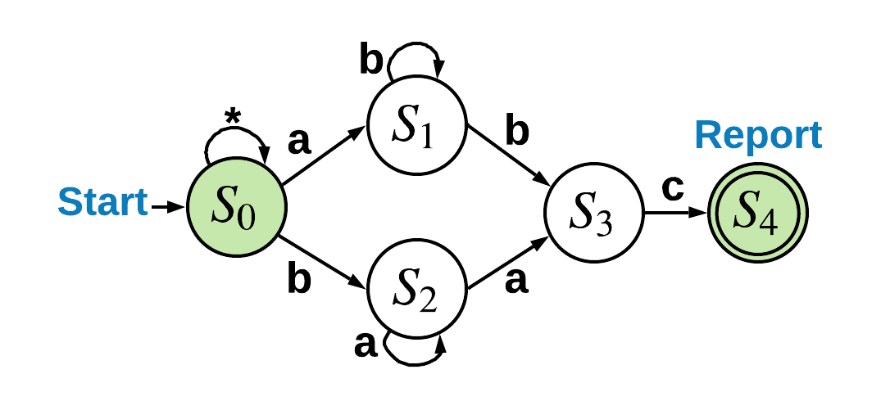
Finite Automata for Pattern Recognition Languages
Regular expression: (ab+|ba+) c
Input:
a | b | c | ...
Non-deterministic Finite Automata (NFA)

Slide 10
Challenges: von Neumann Processors Easily Become Memory Bound
Unpredictable behavior (branch misprediction)
Irregular access pattern (cache miss)
Many parallel patterns (saturate memory bandwidth)

Slide 11

Why In-Memory Processing is Suitable for Pattern Matching?
Significance and Generality
Memory Bound
Parallelism
Simplicity

Slide 12

Non-deterministic finite automata processing
with
Processing in-memory architecture

Slide 13
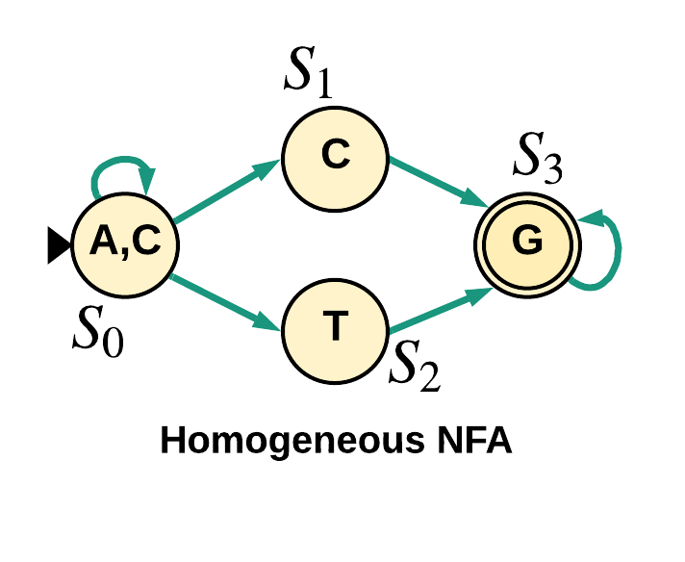
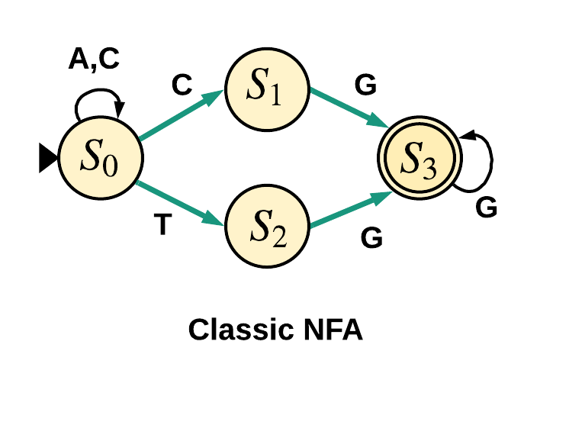
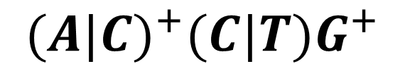
Regular expression:
$${(A|C)}^{+}{(C|T)G}^{+}$$
Equivalent
Homogenous model aligns well with HW implementation

Slide 14
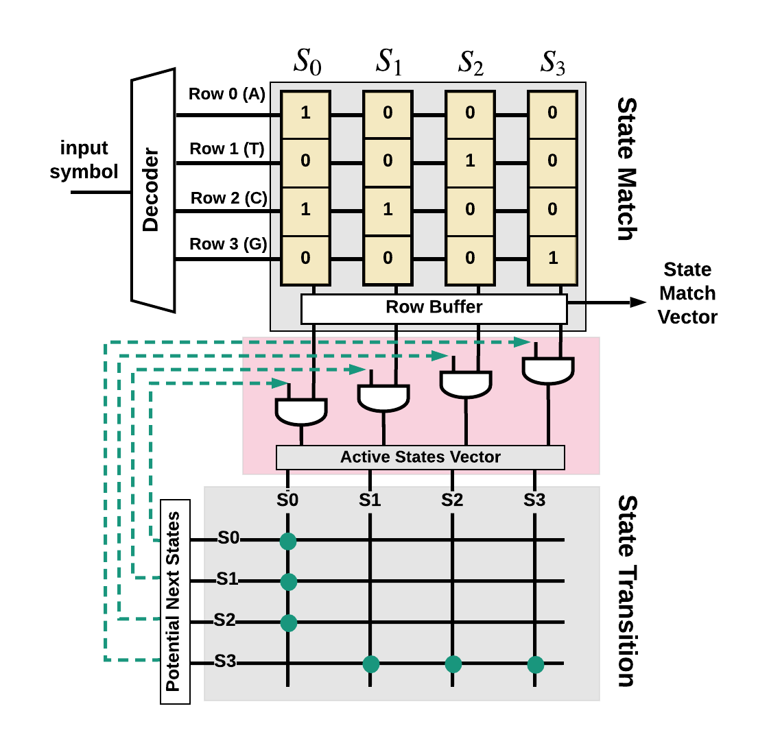
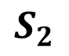
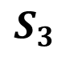
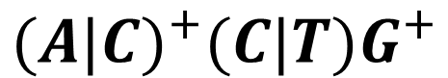
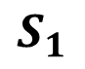
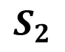
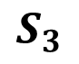
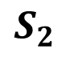
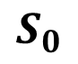
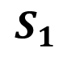
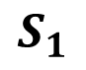
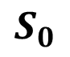
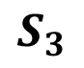
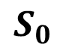
$${(A|C)}^{+}{(C|T)G}^{+}$$
C
$$S_{0}$$
$$S_{1}$$
$$S_{2}$$
$$S_{3}$$
Potential next states
1 | 1 | 1 | 0
$$S_{0}$$
$$S_{1}$$
$$S_{2}$$
Bitwise AND
$$S_{3}$$
State match vector
1 | 1 | 0 | 0
$$S_{0}$$
$$S_{1}$$
$$S_{2}$$
$$S_{3}$$
Next Active States
1 | 1 | 0 | 0

Slide 15
$${(A|C)}^{+}{(C|T)G}^{+}$$
C
$$S_{0}$$
$$S_{1}$$
$$S_{2}$$
$$S_{3}$$
Potential next states
1 | 1 | 1 | 0
$$S_{0}$$
$$S_{1}$$
$$S_{2}$$
Bitwise AND
$$S_{3}$$
State match vector
1 | 1 | 0 | 0
$$S_{0}$$
$$S_{1}$$
$$S_{2}$$
$$S_{3}$$
Next Active States
1 | 1 | 0 | 0

Slide 16
$${(A|C)}^{+}{(C|T)G}^{+}$$
C
(10)
$$S_{0}$$
$$S_{1}$$
$$S_{2}$$
$$S_{3}$$
Potential next states
1 | 1 | 1 | 0
$$S_{0}$$
$$S_{1}$$
$$S_{2}$$
Bitwise AND
$$S_{3}$$
State match vector
1 | 1 | 0 | 0
$$S_{0}$$
$$S_{1}$$
$$S_{2}$$
$$S_{3}$$
Next Active States
1 | 1 | 0 | 0

Slide 17
$${(A|C)}^{+}{(C|T)G}^{+}$$
C
(10)
$$S_{0}$$
$$S_{1}$$
$$S_{2}$$
$$S_{3}$$
Potential next states
1 | 1 | 1 | 0
$$S_{0}$$
$$S_{1}$$
$$S_{2}$$
Bitwise AND
$$S_{3}$$
State match vector
1 | 1 | 0 | 0
$$S_{0}$$
$$S_{1}$$
$$S_{2}$$
$$S_{3}$$
Next Active States
1 | 1 | 0 | 0

Slide 18
$${(A|C)}^{+}{(C|T)G}^{+}$$
C
(10)
$$S_{0}$$
$$S_{1}$$
$$S_{2}$$
$$S_{3}$$
Potential next states
1 | 1 | 1 | 0
$$S_{0}$$
$$S_{1}$$
$$S_{2}$$
Bitwise AND
$$S_{3}$$
State match vector
1 | 1 | 0 | 0
$$S_{0}$$
$$S_{1}$$
$$S_{2}$$
$$S_{3}$$
Next Active States
1 | 1 | 0 | 0

Slide 19
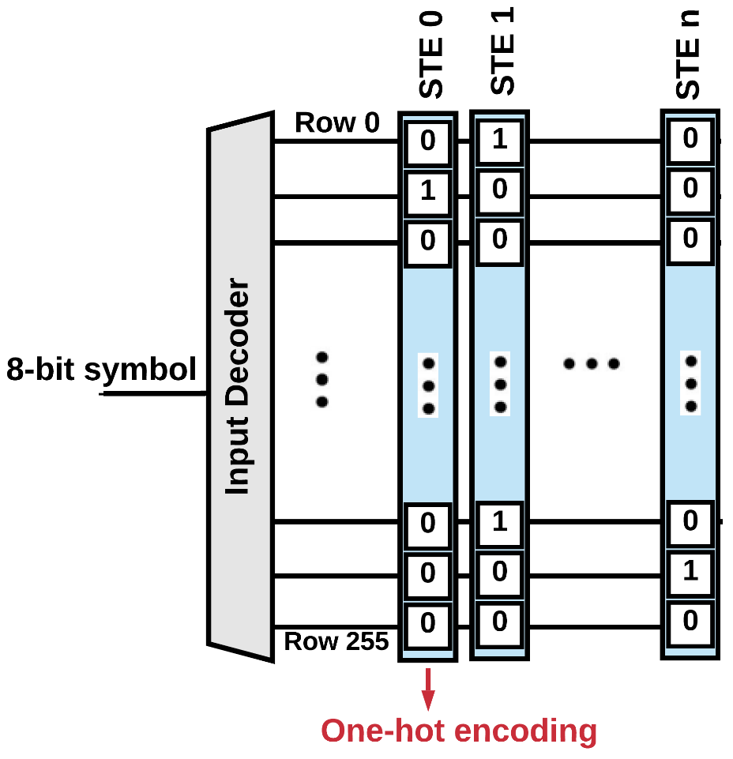



Challenges in PIM Solutions
Symbol Sparsity
8-bit processing
Algorithm PIM Architecture
Throughput
Area Efficiency
Energy Efficiency

Slide 20
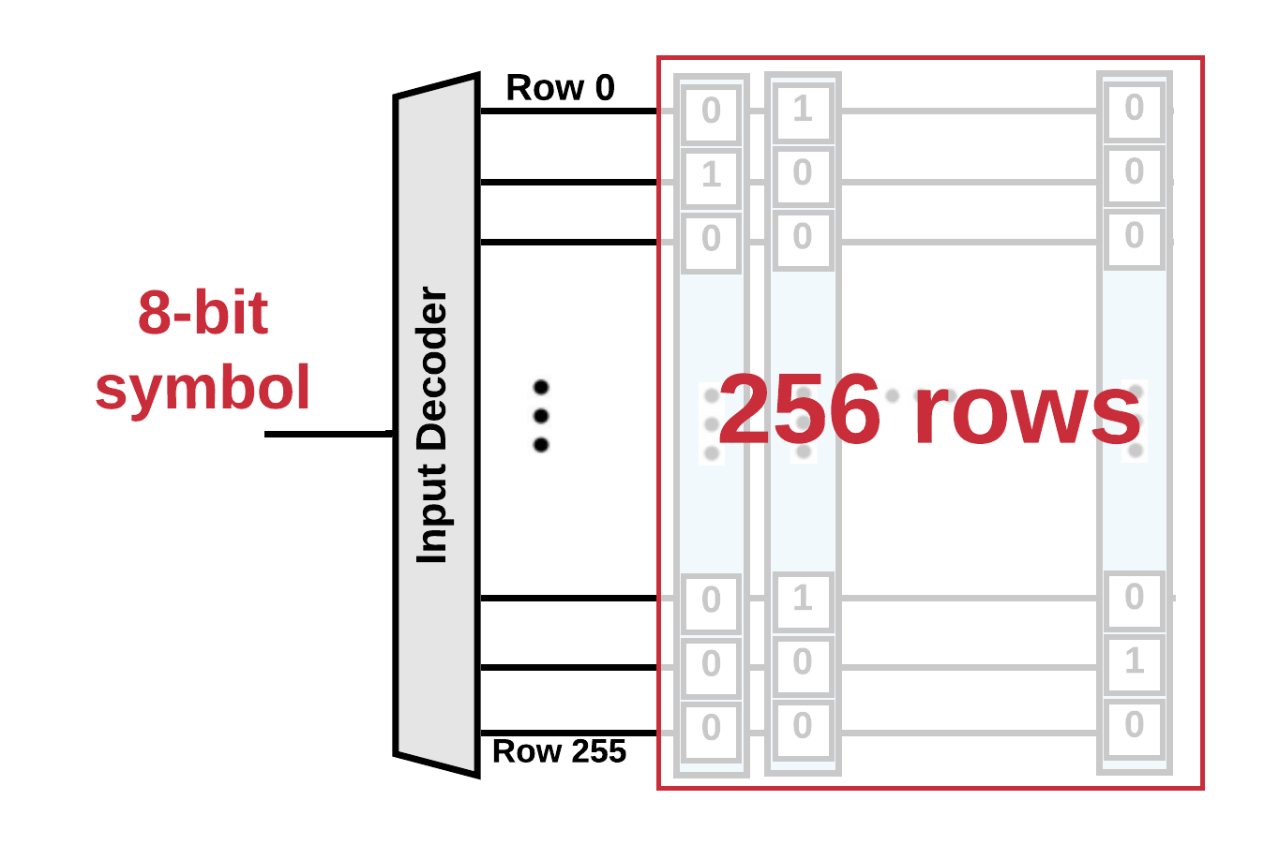
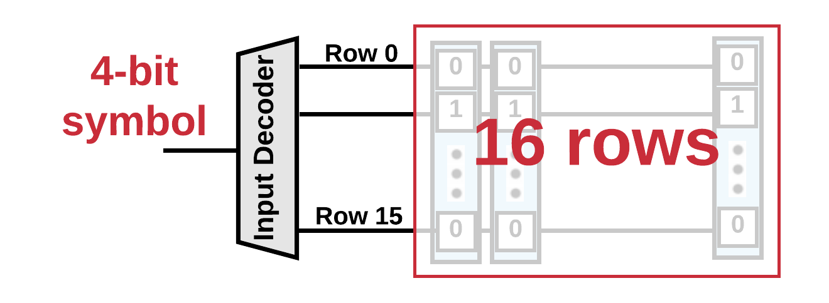

Overview of Our Solution
Squashing
Area Efficiency
8-bit NFA
FlexAmata
Engine
4-bit NFA
Energy Efficiency
Architecture Implication
Reducing sparsity

Slide 21
Overview of Our solution
Squashing
Area Efficiency
8-bit NFA
FlexAmata
Engine
4-bit NFA
Energy Efficiency
Vectorized Striding
4-bit NFA
FlexAmata
Engine
16-bit NFA
Throughput Gain
Architecture Implication
Longer and Serial → Shorter and Parallel

Slide 22
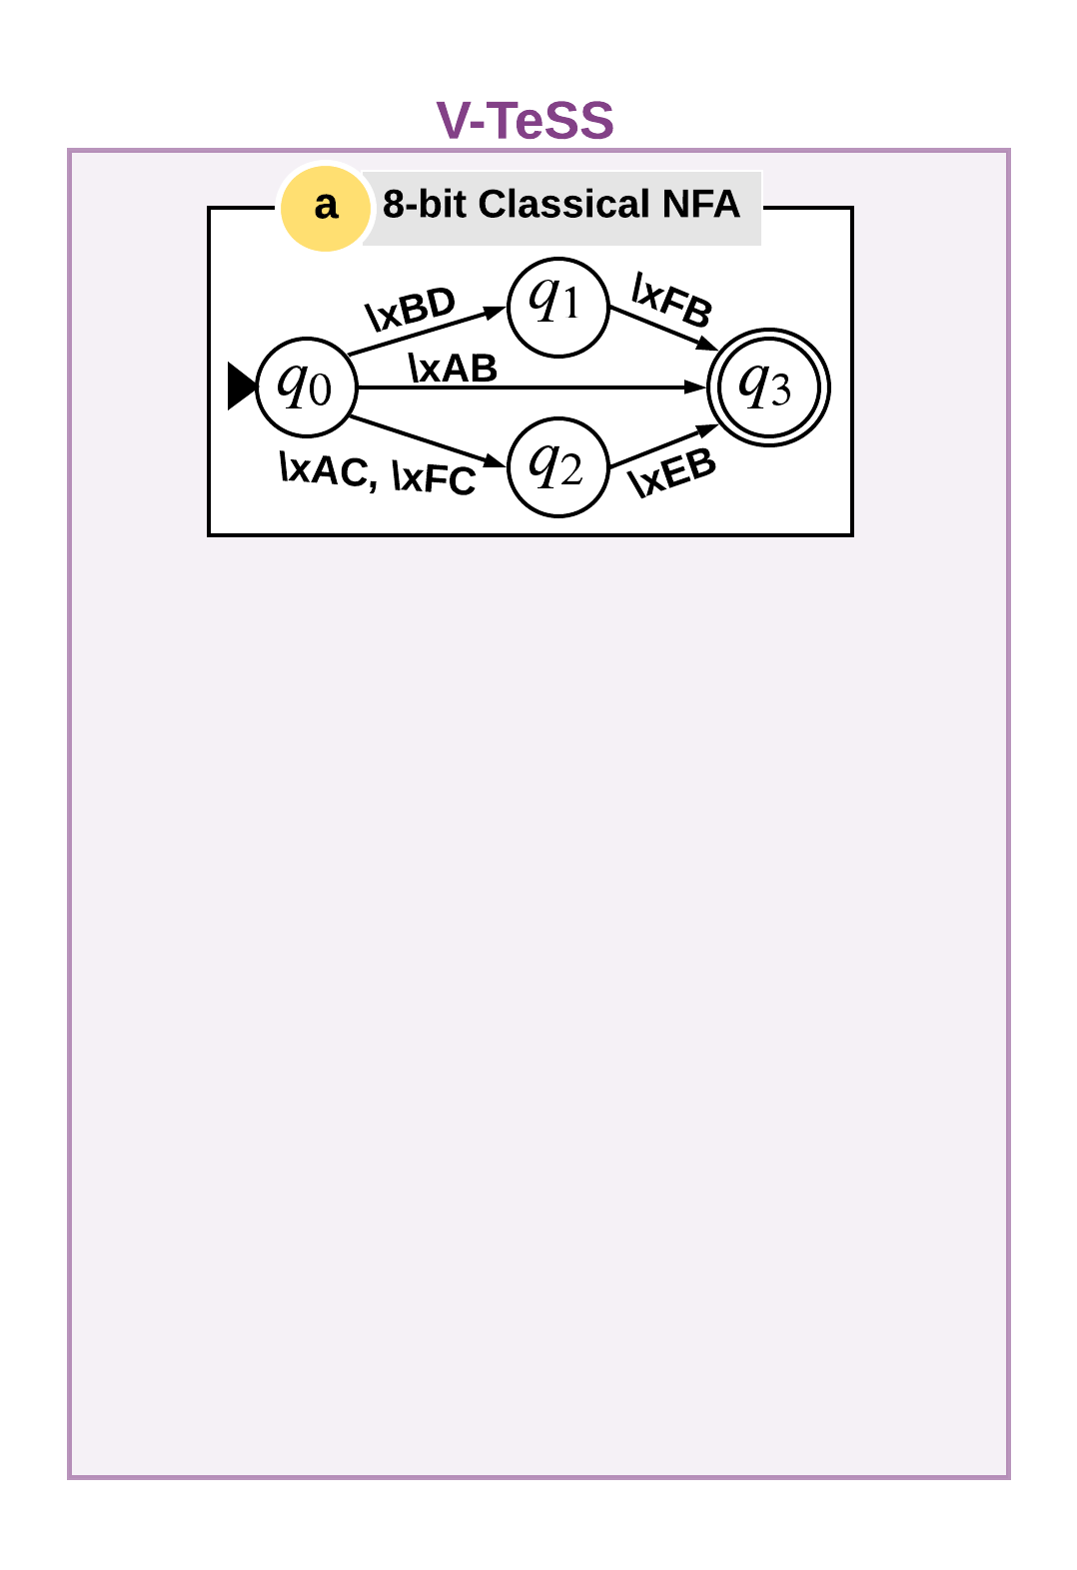
Vectorized Temporal Squashing and Striding (V-TeSS)

Slide 23
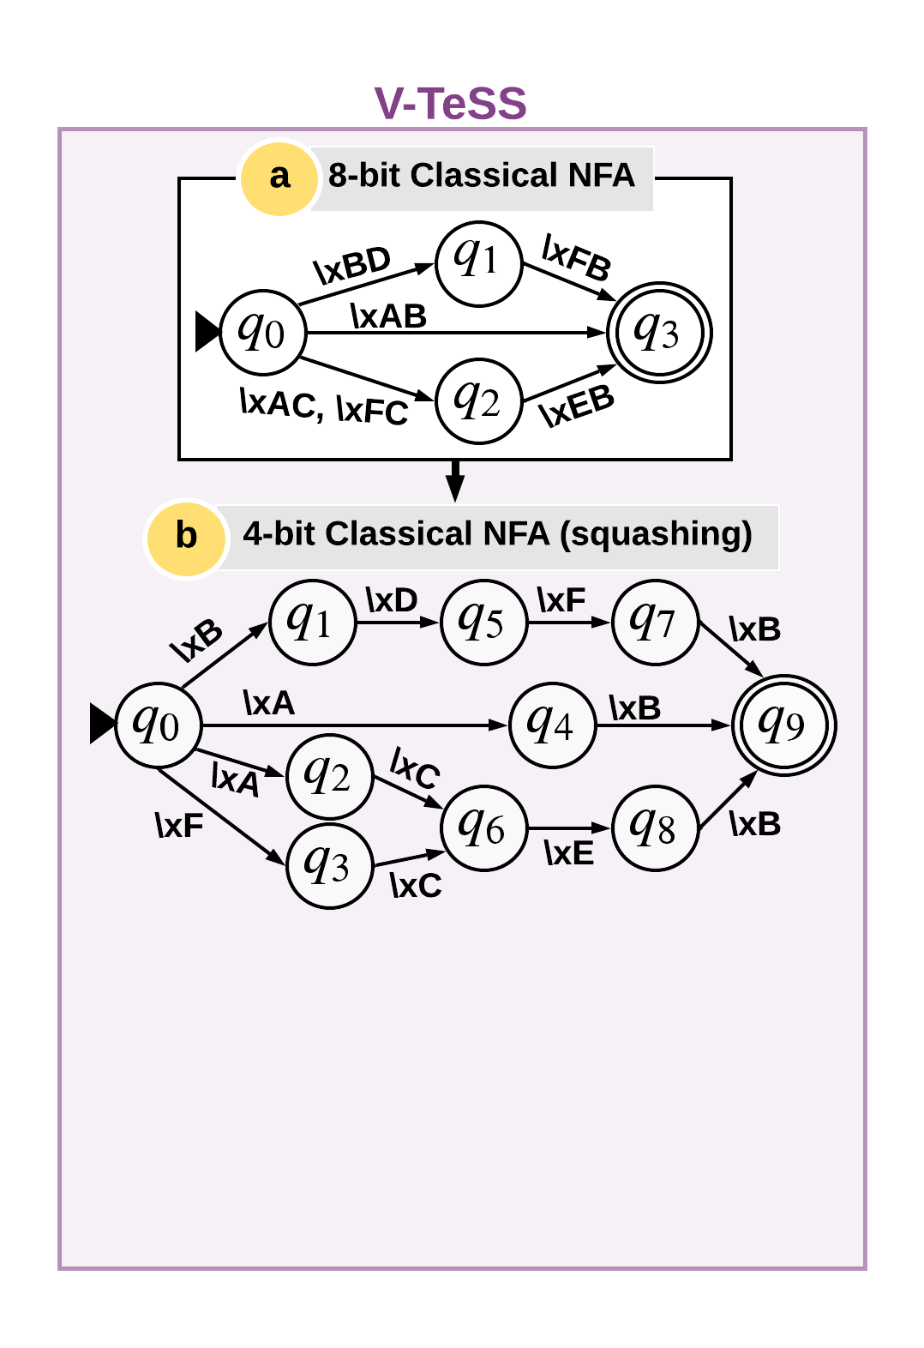
Vectorized Temporal Squashing and Striding (V-TeSS)

Slide 24
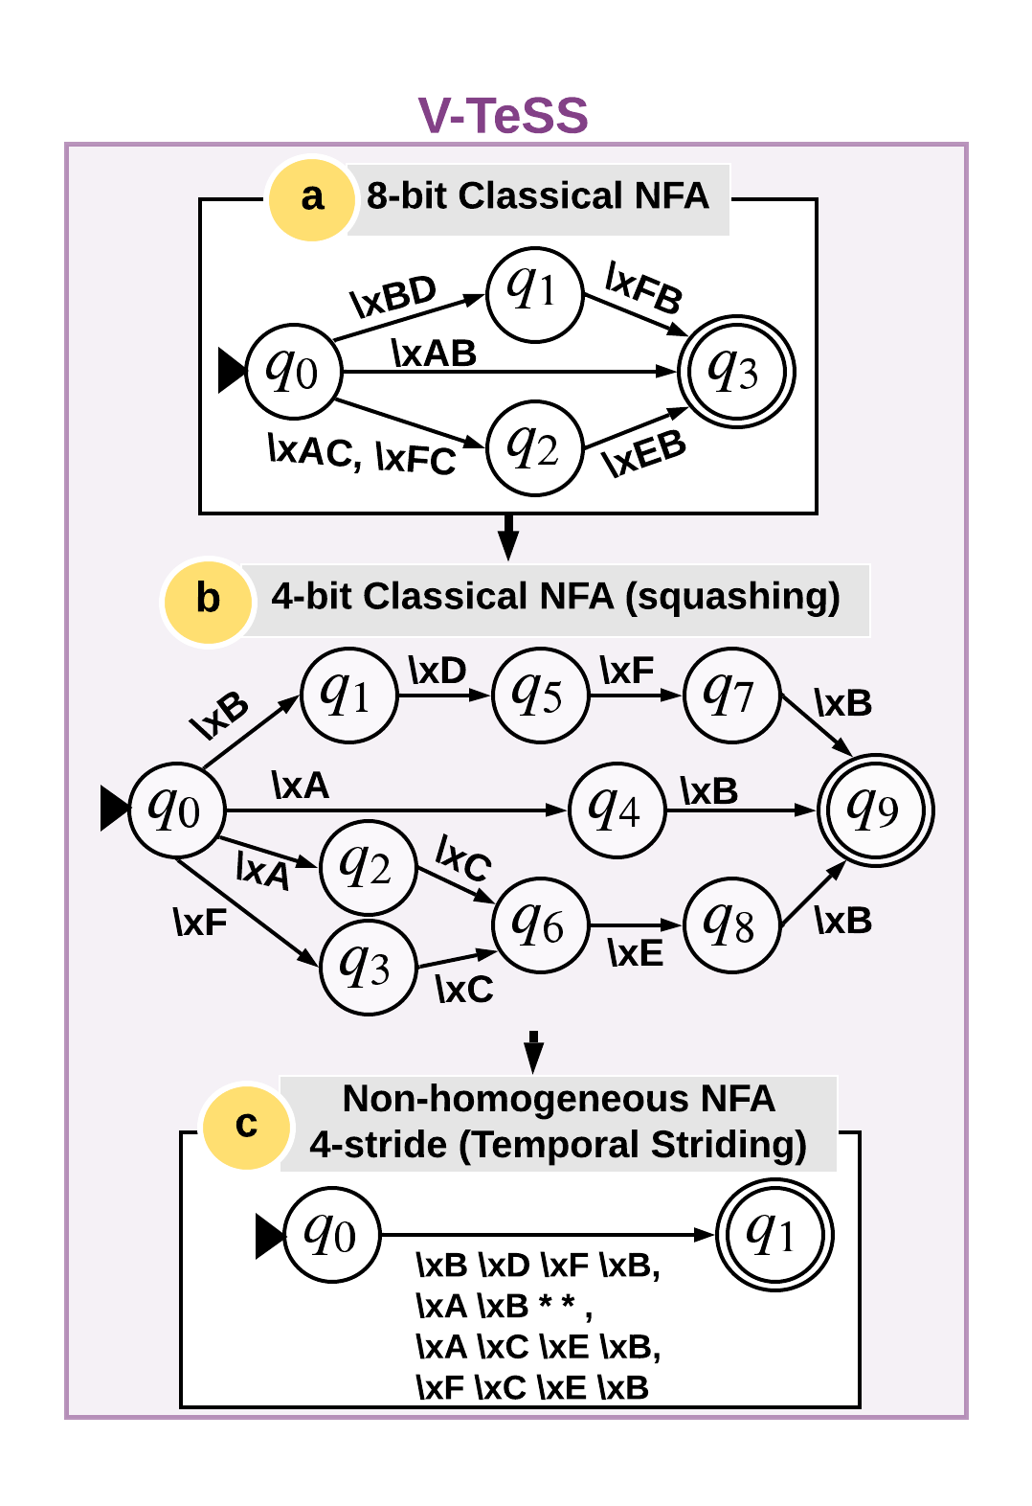
Vectorized Temporal Squashing and Striding (V-TeSS)
Average 1.68X state overhead
(1X – 5.11x)

Slide 25
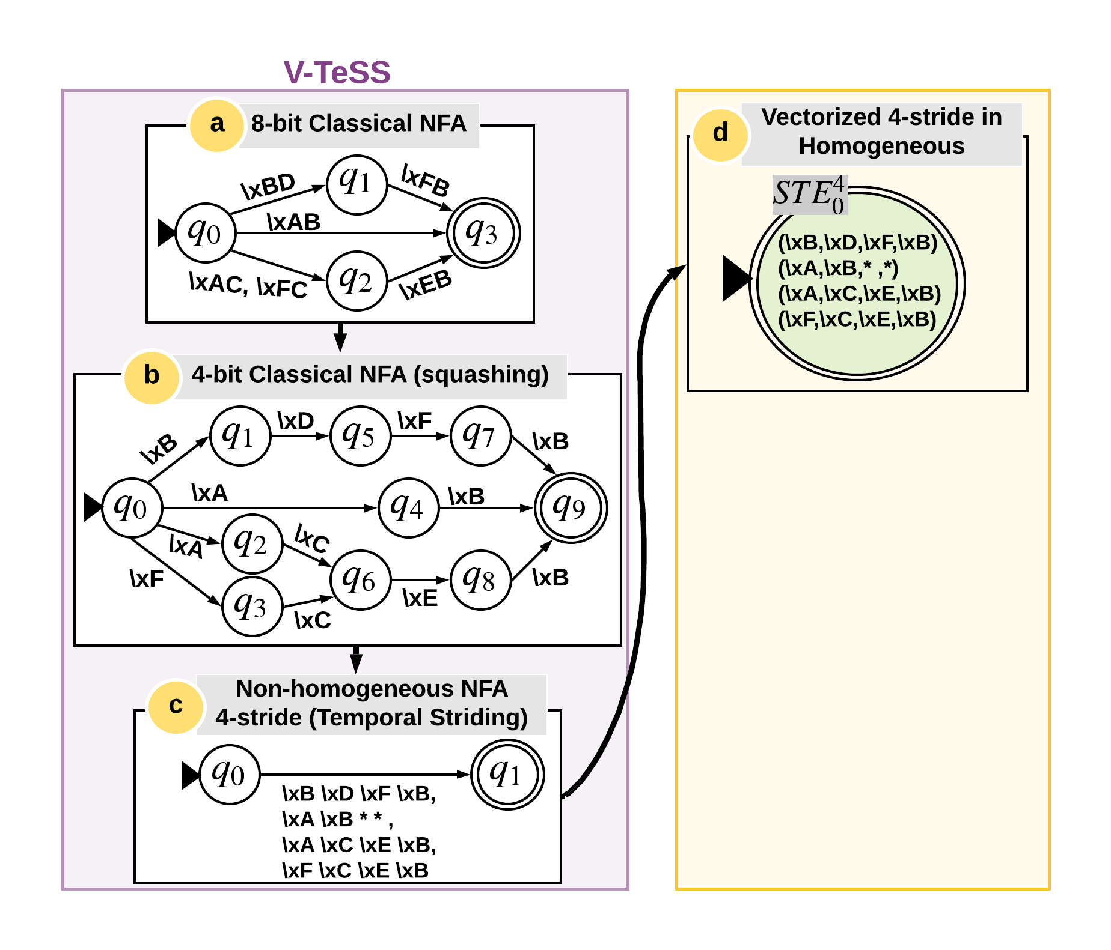
Vectorized Temporal Squashing and Striding (V-TeSS)

Slide 26
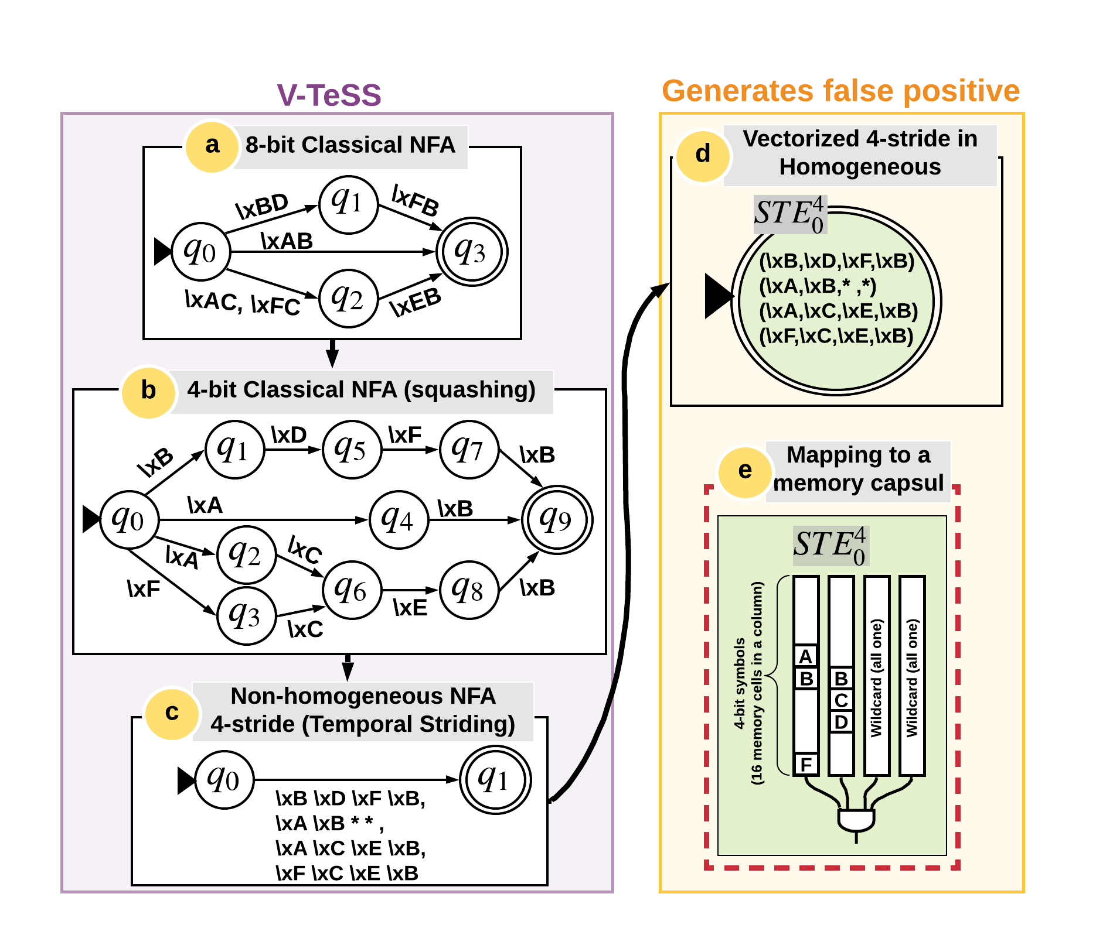
Vectorized Temporal Squashing and Striding (V-TeSS)
False positive:
\xF, \xC, \xF, \xB

Slide 27
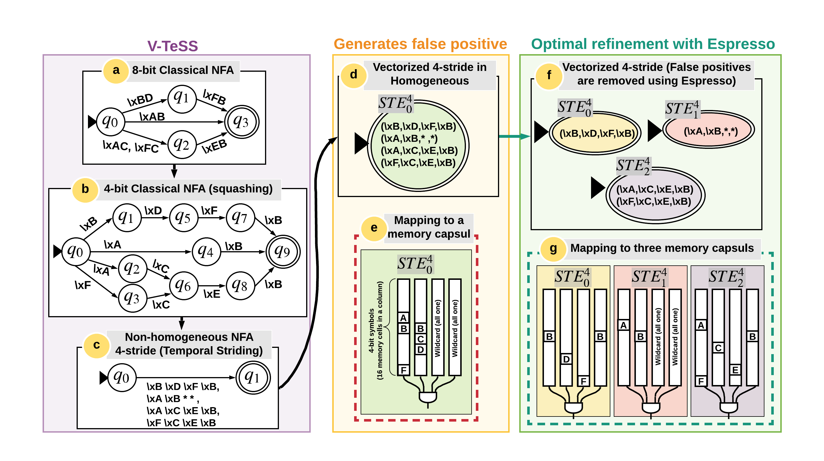
Vectorized Temporal Squashing and Striding (V-TeSS)
Broader impact: minimizing multi-value variables in PIM solutions

Slide 28
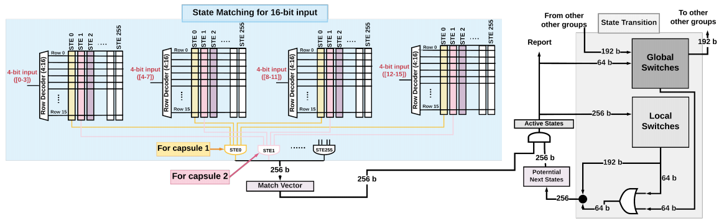
Hardware Support: Impala
Area-efficiency: One 256× 256 → four 16×256 blocks
Throughput efficiency: 8-bit processing → 16-bit processing
Lower energy: smaller subarray size

Slide 29
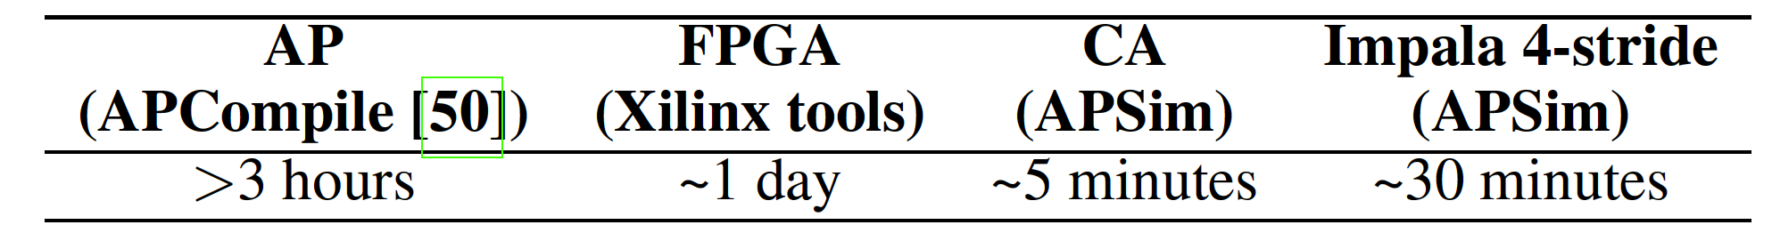
Hardware Support: Impala
Area-efficiency: One 256× 256 → four 16×256 blocks
Throughput efficiency: 8-bit processing → 16-bit processing
Lower energy: smaller subarray size
At the expense of higher one time pre-processing time

Slide 30
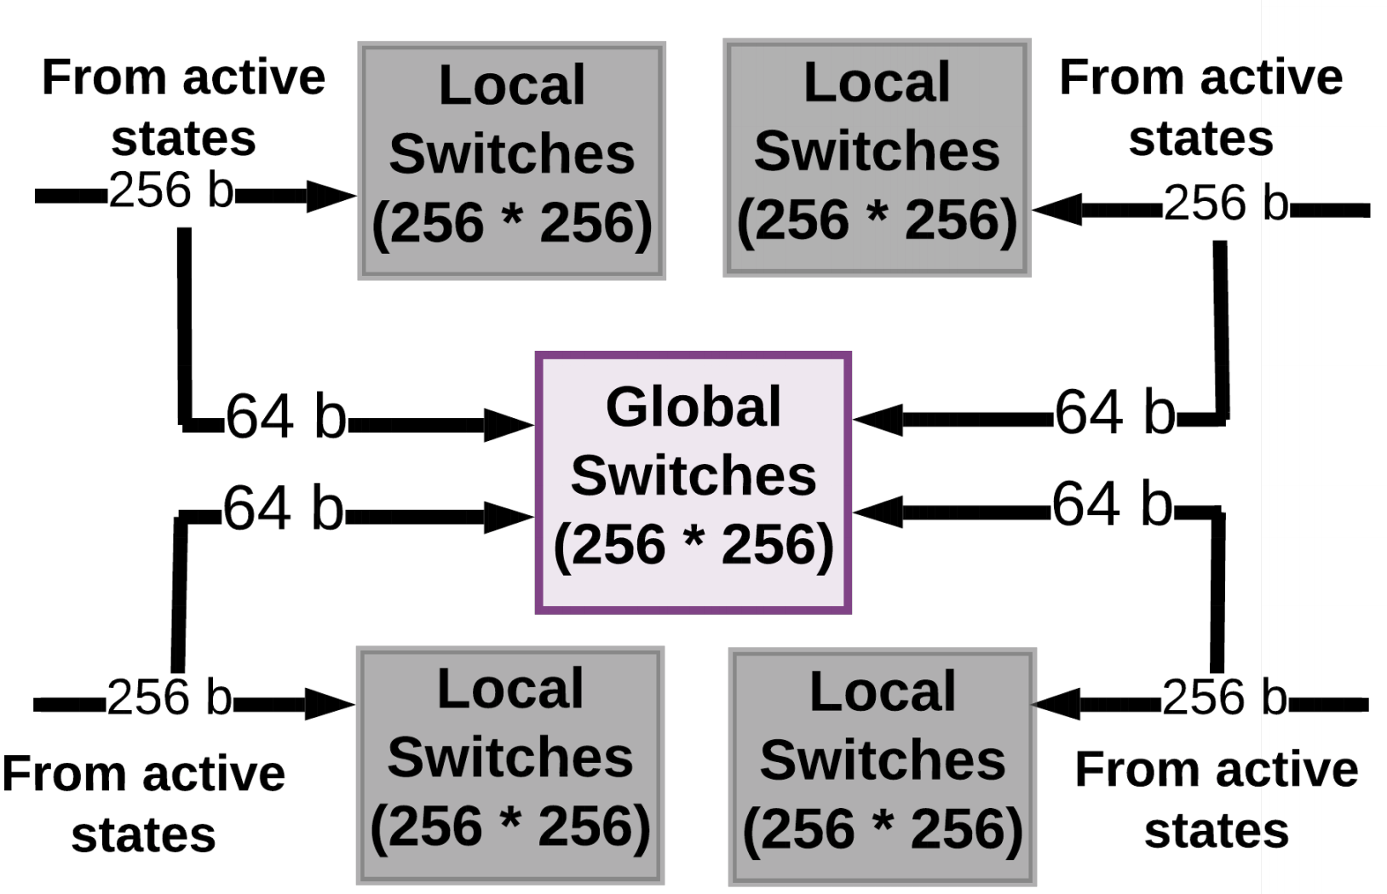
Scalable Interconnect
State Matching Subarrays
State Matching Subarrays
State Matching Subarrays
State Matching Subarrays
Tuesday, 4:10pm, Best of CAL Session

Slide 31
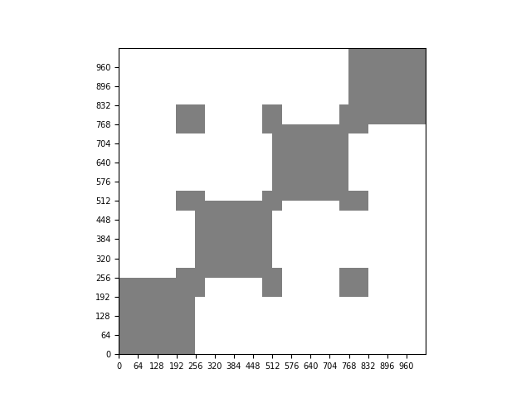
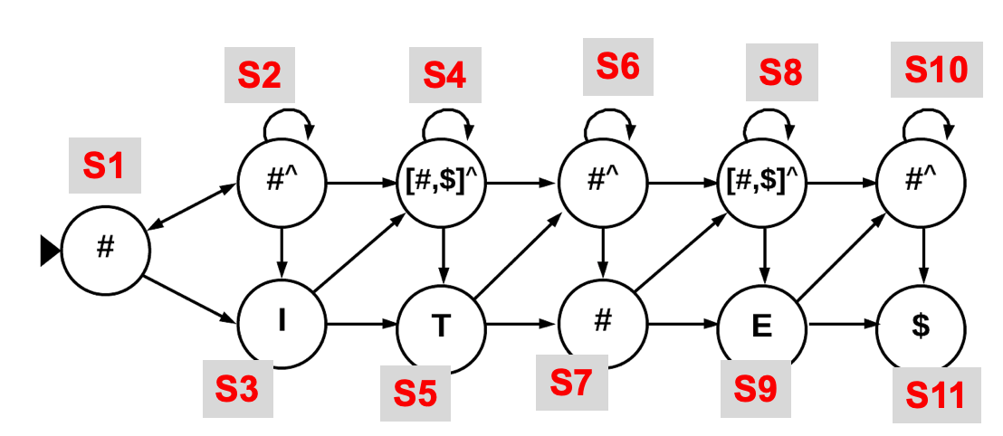
Scalable Interconnect
A
B
D
C
Destination State
B
C
D
A
Source State
Visualization of interconnect resources

Slide 32
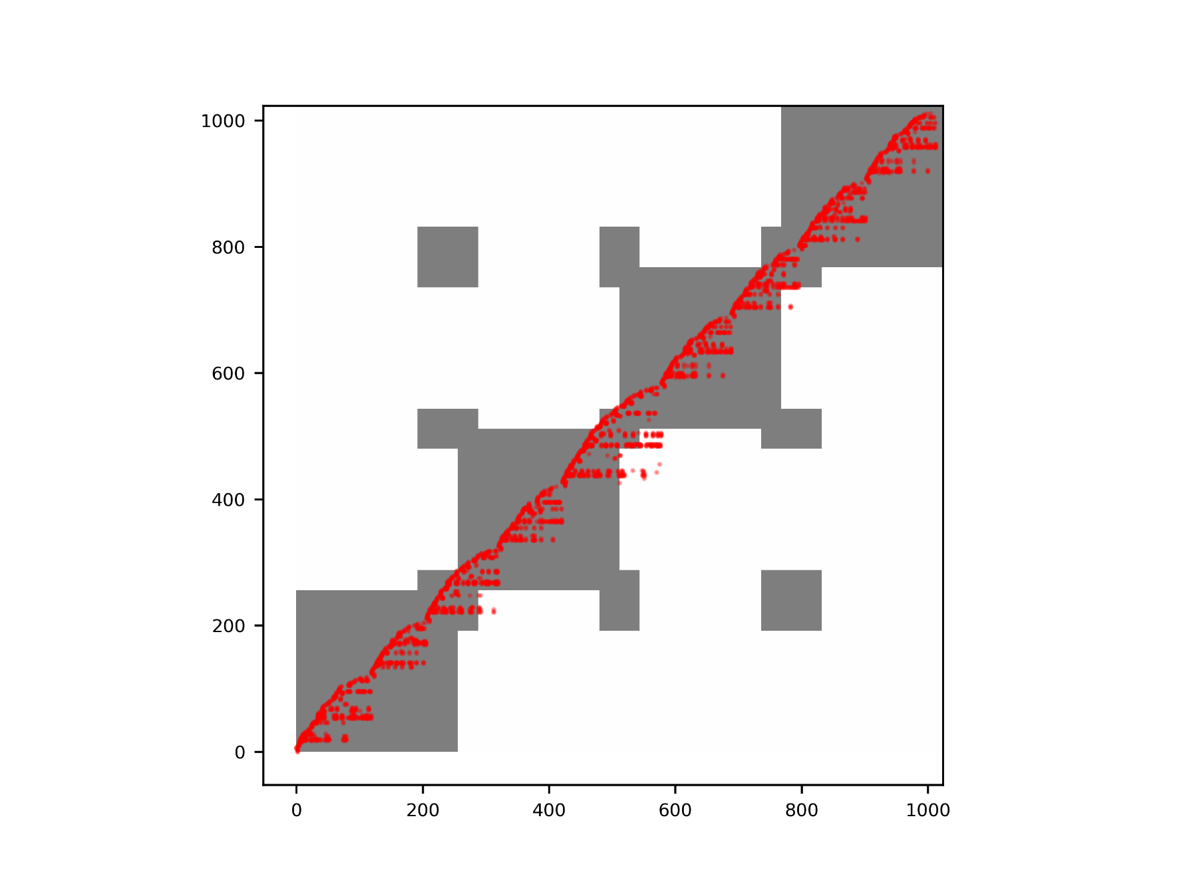
Scalable Interconnect
Destination State
Breadth first labeling
Source State
Visualization of interconnect resources

Slide 33
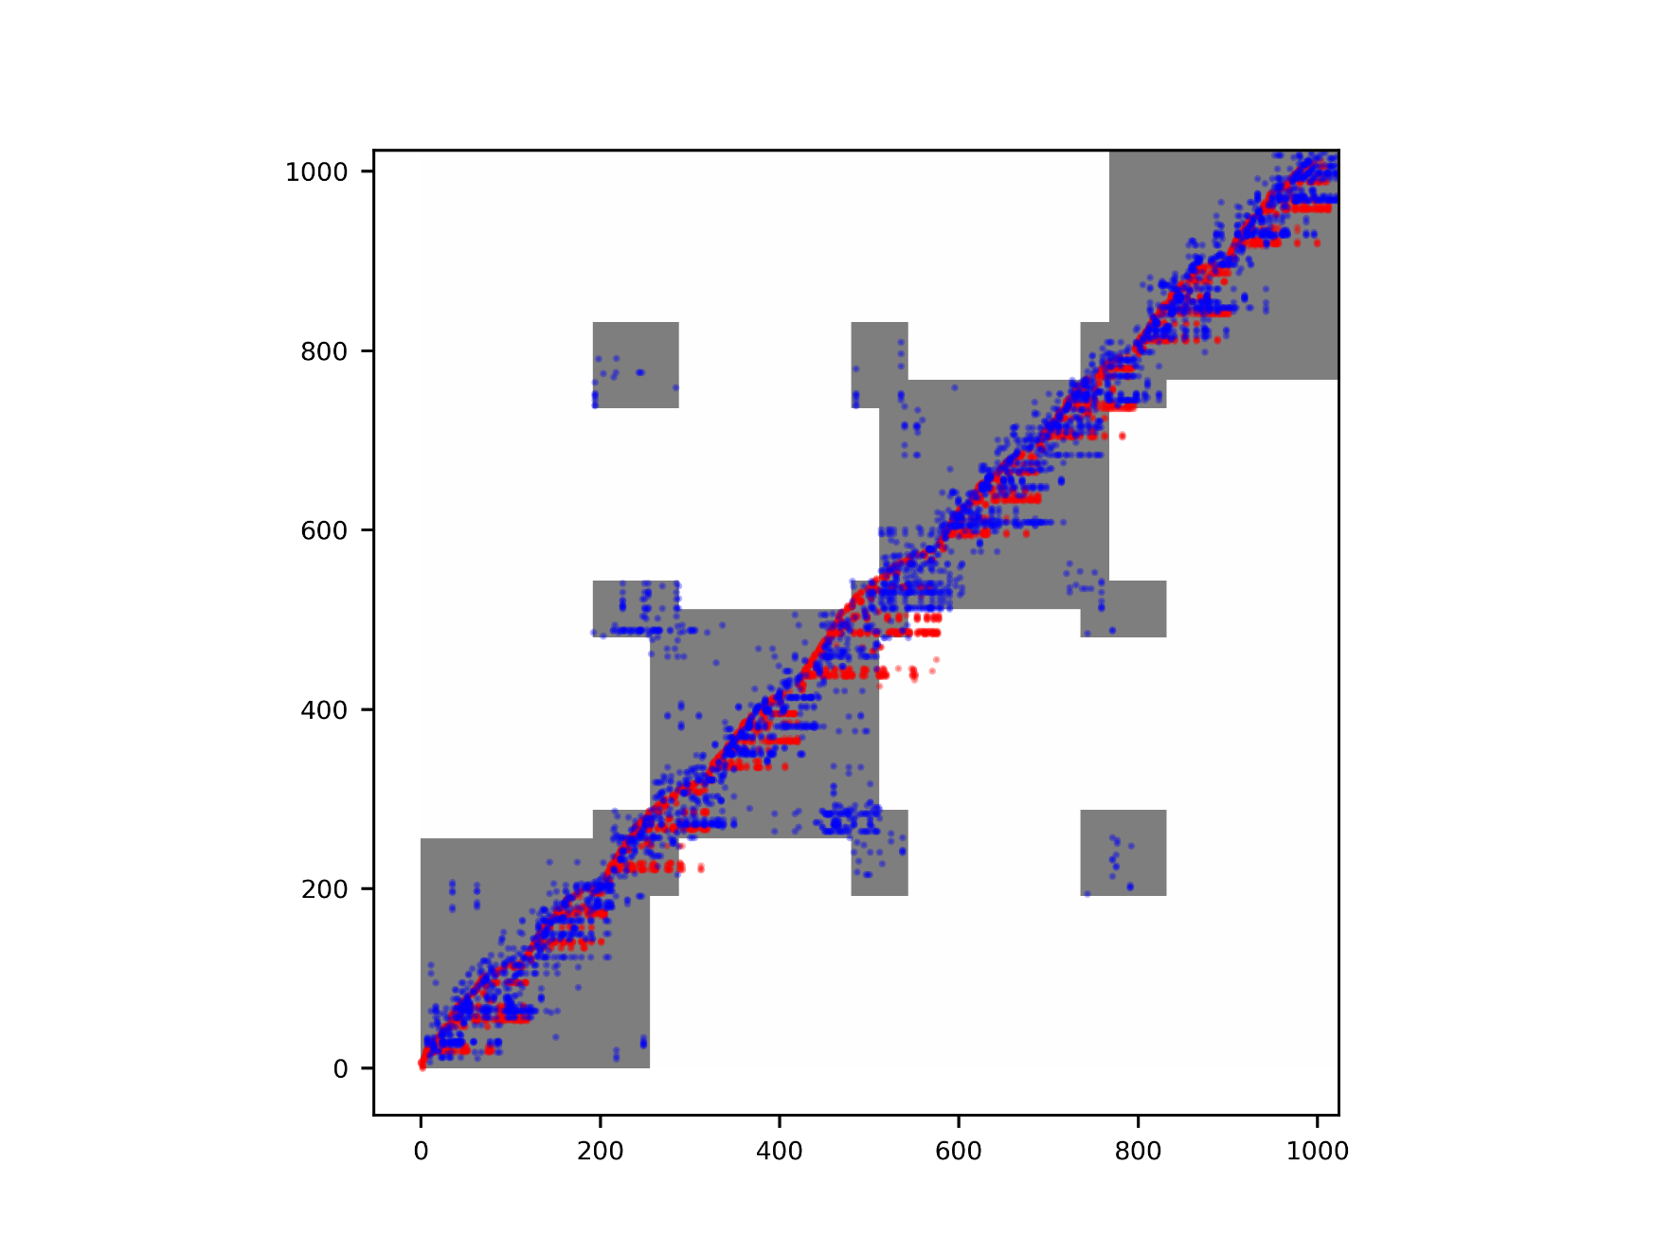
Scalable Interconnect
Destination State
Genetic Algorithm
Source State
Visualization of interconnect resources

Slide 34
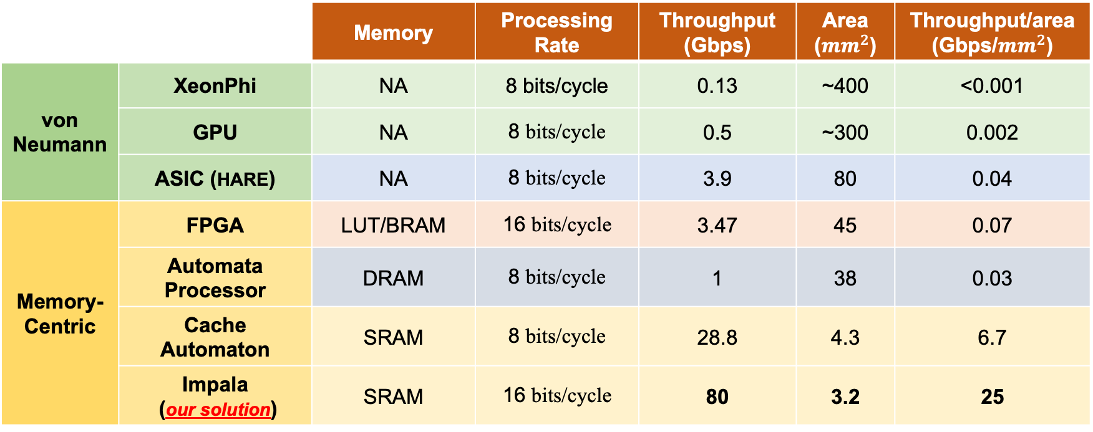
Comparison Across Architectures
Performance factors: Throughput and Density
Benchmark: 1000 Regexes, 40,000 states
 |  | Memory | Processing Rate | Throughput (Gbps) | Area (${mm}^{2}$) | Throughput/area (Gbps/${mm}^{2}$)
von Neumann | XeonPhi | NA | 8 bits/cycle | 0.13 | ~400 | <0.001
 | GPU | NA | 8 bits/cycle | 0.5 | ~300 | 0.002
 | ASIC (HARE) | NA | 8 bits/cycle | 3.9 | 80 | 0.04
Memory-Centric | FPGA | LUT/BRAM | 16 bits/cycle | 3.47 | 45 | 0.07
 | Automata Processor | DRAM | 8 bits/cycle | 1 | 38 | 0.03
 | Cache Automaton | SRAM | 8 bits/cycle | 28.8 | 4.3 | 6.7
 | Impala (our solution) | SRAM | 16 bits/cycle | 80 | 3.2 | 25

Slide 35
Comparison Across Architectures
Performance factors: Throughput and Density
Benchmark: 1000 Regexes, 40,000 states
 |  | Memory | Processing Rate | Throughput (Gbps) | Area (${mm}^{2}$) | Throughput/area (Gbps/${mm}^{2}$)
von Neumann | XeonPhi | NA | 8 bits/cycle | 0.13 | ~400 | <0.001
 | GPU | NA | 8 bits/cycle | 0.5 | ~300 | 0.002
 | ASIC (HARE) | NA | 8 bits/cycle | 3.9 | 80 | 0.04
Memory-Centric | FPGA | LUT/BRAM | 16 bits/cycle | 3.47 | 45 | 0.07
 | Automata Processor | DRAM | 8 bits/cycle | 1 | 38 | 0.03
 | Cache Automaton | SRAM | 8 bits/cycle | 28.8 | 4.3 | 6.7
 | Impala (our solution) | SRAM | 16 bits/cycle | 80 | 3.2 | 25

Slide 36
Comparison Across Architectures
Performance factors: Throughput and Density
Benchmark: 1000 Regexes, 40,000 states
 |  | Memory | Processing Rate | Throughput (Gbps) | Area (${mm}^{2}$) | Throughput/area (Gbps/${mm}^{2}$)
von Neumann | XeonPhi | NA | 8 bits/cycle | 0.13 | ~400 | <0.001
 | GPU | NA | 8 bits/cycle | 0.5 | ~300 | 0.002
 | ASIC (HARE) | NA | 8 bits/cycle | 3.9 | 80 | 0.04
Memory-Centric | FPGA | LUT/BRAM | 16 bits/cycle | 3.47 | 45 | 0.07
 | Automata Processor | DRAM | 8 bits/cycle | 1 | 38 | 0.03
 | Cache Automaton | SRAM | 8 bits/cycle | 28.8 | 4.3 | 6.7
 | Impala (our solution) | SRAM | 16 bits/cycle | 80 | 3.2 | 25
Impala provides a general, flexible, efficient, and scalable solution!

Slide 37
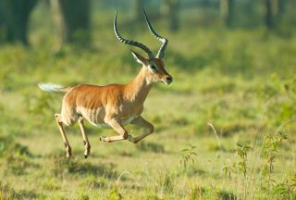
Impala: Main Takeaways
Analyzing application properties for a more efficient architecture
Tall arrays and serial processing → short and parallel arrays
Three-fold throughput, area, energy benefits
Co-designing across the hierarchy for a better PIM solution
https://github.com/gr-rahimi/APSim

